Slide 1
Visibility of Russian Science: Academia, Society, Media
Prof. Leonid Gokhberg First Vice-Rector
TASS, Moscow 08 February 2016

Slide 2
Science, technology and innovation studies at HSE
Revision of the OECD Frascati and Oslo Manuals
Annual R&D, technology and innovation surveys (full international comparability)
Specialised surveys on innovative behaviour of NIS actors & population
Indicators of R&D performance and technology development
Series of annual data books
S&T Foresight 2030 and 2040
National, sectoral, regional and firm-level Foresight projects
National S&T priorities and critical technologies
Monitoring of global technology trends
Technology roadmaps
Statistics
Foresight
Policy
International cooperation
STI strategies
Recommendations on STI policy instruments
STI policy evaluation
Regional Innovation Scoreboard
GLOBELICS
ERA.Net RUS
European Foresight Platform
International Foresight Academy
STI co-operation in APEC region
OECD Government Foresight Network
International MSc Programme “Governance of Science, Technology, and Innovation”: http://issek.hse.ru/en/sti
Academic journal Foresight and STI Governance: http://foresight-journal.hse.ru/en
Book series on STI studies with Springer: http://www.springer.com/series/13398

Slide 3
Outline
Major R&D indicators
Scientific visibility
Public perceptions of S&T
Media visibility

Slide 4
Major R&D indicators
R&D expenditure (RUR bln in 1989 prices)
R&D personnel (thousands)
847.5 (RUR bln in current prices)
R&D organisations
4646
4099
3536
3604
Source: HSE ISSEK

Slide 5
Gross Domestic Expenditure on R&D: 2014 (current PPP $, million)
Sources: HSE ISSEK, OECD

Slide 6
Visibility of Russian science
For academia
For society
Visibility
For media

Slide 7
Visibility of Russian science
For academia

Slide 8
Russian publications: gradual recovery
For academia
Global rank = 9
Global rank = 15
Source: HSE ISSEK based on Web of Science

Slide 9
Country rankings: share of the world total publications (%)
For academia
Source: HSE ISSEK based on Web of Science

Slide 10
Country rankings: citations per paper
For academia
Source: HSE ISSEK based on Essential Science Indicators

Slide 11
Scientific specialisation of Russian science: 2014*
For academia
World
* Revealed comparative advantage index (RCA)
Source: HSE ISSEK based on Web of Science

Slide 12
International collaborations
For academia
Key partners for Russia: USA, Germany, France, UK, Italy
Source: HSE ISSEK based on Web of Science

Slide 13
Visibility of Russian science
For society

Slide 14
Public perception of impacts of S&T
For society
Respondents with positive answers to a question: “Do you think that the overall influence of science on our society is positive or negative?” (%)
The
Sources: Russia – HSE Monitoring Survey of Innovative Behaviour of Population (2014); EU countries – Eurobarometer (2013)

Slide 15
Public awareness of S&T
For society
Respondents with positive answers to a question: “How informed do you feel about developments in science and technology?” (%)
The
Sources: Russia – HSE Monitoring Survey of Innovative Behaviour of Population (2014); EU countries – Eurobarometer (2013)

Slide 16
Topics of interest in Russia
For society
Respondents with positive answers to a question: “How are you interested in the following topics?” (%)
The only growing areas
Sources: HSE Monitoring Survey of Innovative Behaviour of Population (2006-2014)

Slide 17
Whom do people trust?
For society
Respondents with positive answers to a question: “Who are the best qualified to explain the impact of scientific and technological developments on society?” (%)
Sources: Russia – HSE Monitoring Survey of Innovative Behaviour of Population (2014); EU countries – Eurobarometer (2013)

Slide 18
Visibility of Russian science
For media

Slide 19
Russian science in the world press
For media
Messages containing information about scientific achievements in different countries
Source: HSE ISSEK based on Factiva (2015)

Slide 20
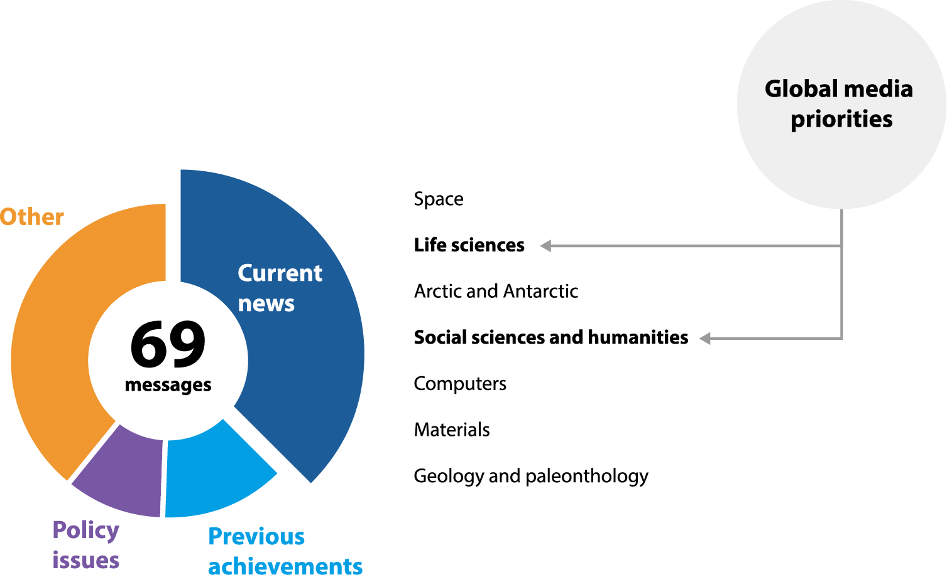
Hot topics about Russian science in the top-8 global media sources
For media
Coverage: The Wall Street Journal, The New York Times, Financial Times, The Guardian, The Economist, The Times (UK), Forbes, Newsweek
Source: HSE ISSEK based on Factiva (2014–2015)

Slide 21
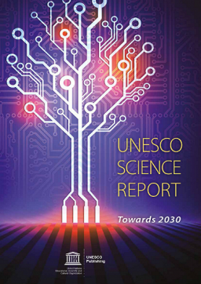
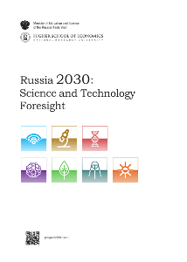
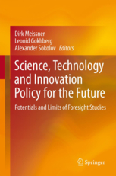
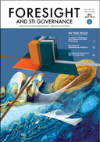
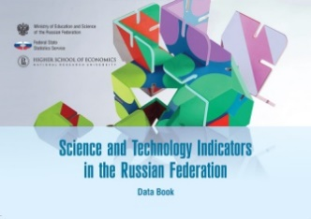
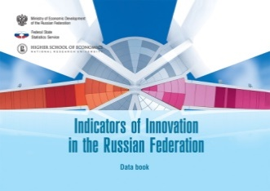
HSE publications on STI
Russia in UNESCO Science Report: towards 2030
UNESCO Publishing, 2015
URL: http://goo.gl/CSQRfJ
Russia 2030:
S&T Foresight
Moscow: HSE, 2015
URL: http://goo.gl/ll9aqa
The quarterly
HSE academic journal
Foresight and STI Governance
URL: http://foresight-journal.hse.ru/en
Book series with Springer:
Science, Technology and Innovation Studies
URL: http://www.springer.com/series/13398
HSE data books series URL: http://goo.gl/cvR8nN
Science and Technology Indicators in the Russian Federation. Data book: 2016
Indicators of Innovation in the Russian Federation. Data book: 2016
Science and Technology. Innovation. Information Society. Pocket data book: 2016

Slide 22
Thank you!
lgokhberg@hse.ru

